Slide 1
Optimizing multicomponent interventions:
The Multiphase Optimization Strategy (MOST) – factorial and SMART designs
Raul U. Hernandez-Ramirez, PhD
Research Scientist in Biostatistics, Yale School of Public Health
Primary Faculty, Center for Methods in Implementation and Prevention Science (CMIPS)
Core Director, Dissemination and Implementation Science Methods (DISM) core at Center for Interdisciplinary Research on AIDS (CIRA)

Slide 2
Multiphase Optimization Strategy (MOST)
  Introduction to MOST
  Phases of MOST
    Optimization trials
      Factorial designs
      Sequential multiple-assignment randomized trial (SMART) design
  Examples of the use of MOST
  Presentation heavily based on
    Collins, L.M. (2018). Optimization of Behavioral, Biobehavioral, and Biomedical Interventions: The Multiphase Optimization Strategy (MOST). New York: Springer.
    Collins, L.M. Training on Optimization of Behavioral and Biobehavioral Interventions 2019

Slide 3
Multiphase optimization strategy (MOST)
Engineering-inspired framework for optimizing multicomponent interventions
Multicomponent interventions are interventions with more than one component

Slide 4
Multicomponent interventions
May be aimed at:
  Prevention or treatment
  Health, social, behavioral, or educational outcomes and implementation outcomes
May consist of:
  Behavioral, pharmaceutical, medical, or surgical components
  Components targeting different and/or multiple levels of influence (multilevel interventions)
Examples
  Tobacco dependance treatment
  Interventions to get people with HIV in care
  Treatment for depression or other mental health conditions
Environmental
Organizational
Interpersonal
Individual

Slide 5
Intervention components
(building blocks)
Any part of an intervention that can be separated out for experimental study
Parts of SKILLS can be also components
Motivational interviewing (MI); Peer mentoring (PEER); Text message support (TEXT); Mindfulness meditation (MIND); Behavioral skills training (SKILLS)

Slide 6
Examples of intervention components
Within “public health and clinical interventions” to prevent or treat HIV
  PREP for persons at risk of HIV infection: type, dose, etc.
  HIV medication for people living with HIV: type of medication, dose, etc.
Within “supporting interventions” with patients/clients to help them use or adhere to the public health and clinical interventions
  Education about PREP for persons at risk of HIV infection : content of the curriculum, number or type of sessions, etc.
  Reminders for people living with HIV: patient reminder phone calls or text messages
Within “implementation strategies” targeting the health system (e.g., providers) to enhance the adoption, implementation, and sustainability of a supporting intervention or public health or clinical intervention
  Train providers on PREP and HIV medication guidelines: content of the curriculum, number or type of sessions, etc.
  Audit-and-feedback for providers on compliance with PREP and HIV care guidelines: nature of delivery, nature of the content, co-interventions, etc.

Slide 7
Hypothetical example:
Developing an intervention to reduce viral load among HIV+ heavy drinkers
Five candidate components:
  Motivational interviewing (MI: no, yes)
      https://motivationalinterviewing.org/understanding-motivational-interviewing
  Peer mentoring (PEER: no, yes)
  Text message support (TEXT: no, yes)
  Mindfulness meditation (MIND: no, yes)
  Behavioral skills training (SKILLS: low intensity, high intensity)
Notes:
In the context of this example, motivational interviewing is a conversation to engage the participant in the process of examining his or her alcohol use and ART adherence.

Slide 8
How to build an intervention out of these components?
MI
PEER
TEXT
MIND
TRAIN
Multi-component intervention
Evaluation via RCT
Classical approach
MI
PEER
TEXT
MIND
TRAIN
Optimized multi-component intervention
Evaluation via RCT
Empirically based optimization
MOST approach

Slide 9
The RCT cannot not tell us
A significant effect WILL NOT tell us
  Which components contribute positively to the overall effect
  Whether:
    A component impact the effects of another
    A component’s contribution offsets its cost
    All the components are really needed
  How to make the intervention more effective, efficient, and scalable
A non-significant effect WILL NOT tell us
  Whether:
    Any components are worth retaining
    One component had a negative effect that offset the positive effect of others
  What went wrong and how to do it better the next time

Slide 10
Optimization of an intervention
Optimization of a multicomponent intervention is the process of identifying an intervention that provides the best expected outcome obtainable within key constraints imposed by the need for efficiency, economy, and/or scalability.
Notes:
Efficiency (optimal use of resources): Degree to which the intervention produces a good outcome while avoiding wasting money, time, or any other valuable resource
Economy (good value): Degree to which intervention produces a good outcome without exceeding budgetary constraints and the degree to which it offers a high degree of effectiveness in exchange for the resources required to implement it.
An intervention that have shown to produce a good outcome may be affordable (economical) but may not be efficient if it wastes resources by including inactive or weak components.
Scalability: Degree to which the intervention can be implemented widely in real-world settings with fidelity

Slide 11
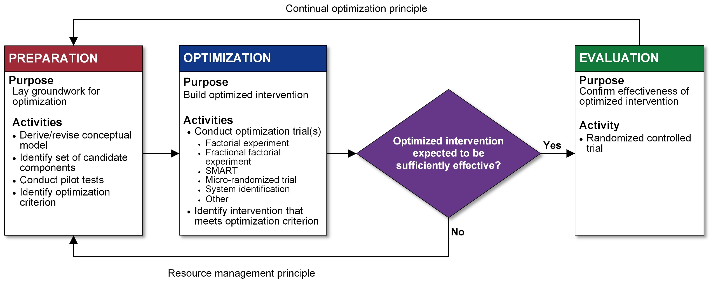
Multiphase optimization strategy (MOST)
(optimization is a process of moving toward an ever-better intervention)
(one must strive to make the best and most efficient use of available resources when obtaining scientific information)
Rectangle = action. Diamond = decision.
https://www.methodology.psu.edu/ra/most/research/
Collins, L. M. (2018). Optimization of behavioral, biobehavioral, and biomedical interventions: the multiphase optimization strategy (MOST). Springer.

Slide 12
MOST
Preparation phase

Slide 13
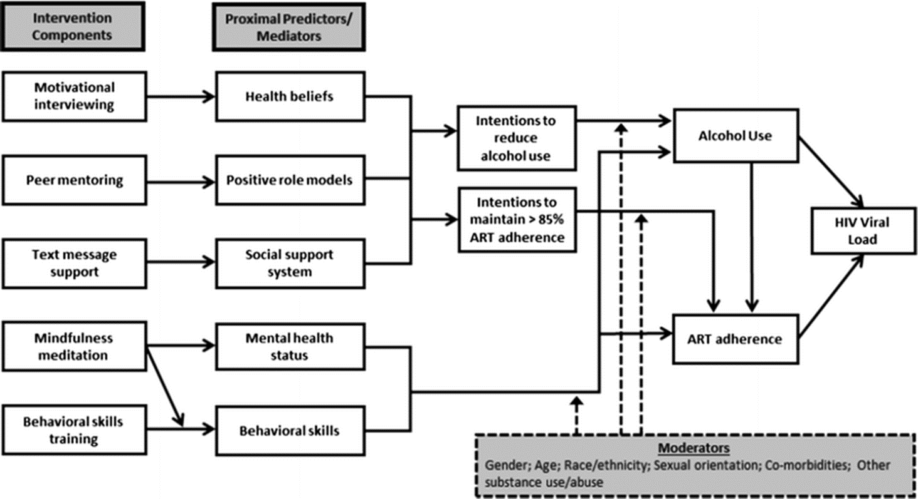
Conceptual model:
Example for the hypothetical HIV example
Effect (measure) modifiers –aka moderators
Collins et al, AIDS and Behavior 2016
Notes:
Conceptual model:
Theory-based and evidence-based
Expresses how the intervention under development intervenes on the behavioral or biobehavioral process
“links each individual intervention component with short- and long-term outcomes, to express which specific components target which specific outcomes”
Guides selection of candidate components (preparation phase) and informs decisions about experimental design (optimization phase)

Slide 14
Identify the optimization criterion
Some options
  All active components
  If there are constraints regarding the magnitude of the component effects, the implementation cost or time
    Most effective intervention that can be implemented for < some $
      “largest expected value of adhere that can be obtained for an implementation cost of no more than $500 per person”
    Most cost-effective component(s)
    Most effective intervention that can be completed in < some time

Slide 15
MOST
Optimization phase

Slide 17
Intervention design vs experimental design
Intervention design
  Specific details of the approach taken by an intervention
    Intervention components (e.g., motivational interviewing, peer mentoring)
    Setting
    Eligible participants
Experimental (study) design
  Design of an experiment needed to develop, optimize, or evaluate an intervention

Slide 18
Hypothetical example:
Developing an intervention to reduce viral load among HIV+ heavy drinkers
Goal: choose from set of components or component levels that best reduces viral load
Five candidate components:
  Motivational interviewing (MI: no, yes)
  Peer mentoring (PEER: no, yes)
  Text message support (TEXT: no, yes)
  Mindfulness meditation (MIND: no, yes)
  Behavioral skills training (SKILLS: low intensity, high intensity)
What kind of optimization trial design?

Slide 19
Experimentation to examine individual intervention components
Objective: To identify the most promising components and levels/settings.
  Efficient screening of intervention components:
    Remove underperforming components
    Learn about the magnitude of each component’s effect
    Examine whether the effect of a component is augmented or reduced in presence of another
NOT to compare each combination to a control or against each other or to identify single best combination
What kind of optimization trial design?

Slide 20
Experimental design options
Five individual treatment vs control experiments
  Motivational interviewing (MI: yes vs no)
  Peer mentoring (PEER: yes vs no)
  Text message support (TEXT: yes vs no)
  Mindfulness meditation (MIND: yes vs no)
  Behavioral skills training (SKILLS: high vs low intensity)
One comparative treatment experiment
  6 experimental conditions: 1. MI, 2. PEER, 3. TEXT, 4. MIND, 5. SKILLS and 6. Control
One factorial experiment
  2⁵ factorial experiment - 32 experimental conditions

Slide 21
Comparison of experimental design options
Comparison of Features of Design Alternatives for Hypothetical HIV Study
Design | Number of Subjects Needed to Maintain Power ≥ .8 (d = .3) | Number of Experimental Conditions | Interactions
A. Five individual experiments | 1,760 | 10 | None can be estimated
B. Comparative treatment | 1,056 | 6 | None can be estimated
C. 2⁵ factorial (complete/full) | 352 | 32 | All can be estimated
d = effect size, standardized mean difference

Slide 22
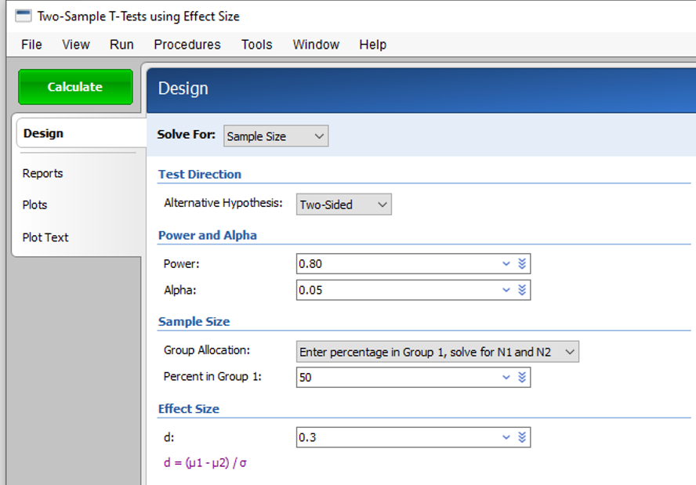
Comparison of experimental design options: sample size calculation
Sample size
For 1 individual treatment vs control experiment
  N per group = 176
  N = 352
For experimental design option A (5 individual experiments)
  Number of factors (p) x N =
  5 X 352 = 1,760
For experimental design option B (comparative treatment)
Number of arms (number of factors (p) plus control arm) x N per group =
(5+1) X 176 =1,056

Slide 23
Comparison of experimental design options: sample size calculation
N (sample size) = 352
p (the number of factors) = 5 two-level components (yes vs no or high vs low) = 5 factors
Design | Number of Subjects Needed to Maintain Power ≥ .8 (d = .3) | Number of Experimental Conditions
A. Five individual experiments | pN= 5 x 352 = 1,760 | 2p = 2 x 5 = 10
B. Comparative treatment | (p + 1 )N/2= (5+1) x 352/2 = 1,056 | p + 1 = 5 + 1 = 6
C. 2⁵ factorial (complete/full) | N = 352 | 2^{p} = 2⁵ = 32

Slide 24
Sample size and power for factorial experiments
Based on main effects; the smallest expected effect size
  Often require many fewer subjects than alternative designs
  Can have very small per-condition n’s and still be well-powered
  Possible to add one or more factors and maintain the same level of power without any increase in the n’
    Unless the expected effect of additional factor is smaller
    An additional level of a factor (e.g., no, low, high); increases numbers of cells and requires increase in N.
Sample size software examples
    Factorial design’s specific (for continuous outcomes only):
      FactorialPowerPlan- SAS and R macros https://scholarsphere.psu.edu/catalog?button=&search_field=creator&q=methodology+center&button=
      PASS – Factorial Analysis of Variance using Effect size and other procedures
    For parallel randomized control trials (use to calculate sample size for each contrast and take the largest one)
      SAS PROC POWER (continuous, binary, and other type outcome data)
      PASS procedures for continuous and binary outcomes
      R power.t.test and power.prop.test

Slide 25
Comparison of experimental design options: sample size calculation for the factorial design using Collins’s SAS macro
%FactorialPowerPlan(assignment=independent, model_order=, nfactors=, power=, d_main=);

Slide 26
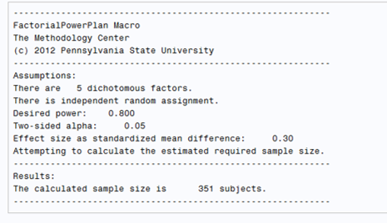
Comparison of experimental design options: sample size calculation for the factorial design using Collins’s SAS macro
%FactorialPowerPlan(assignment=independent, model_order=5, nfactors=5, power=0.8, d_main=0.3);
Rounded up to 352

Slide 27
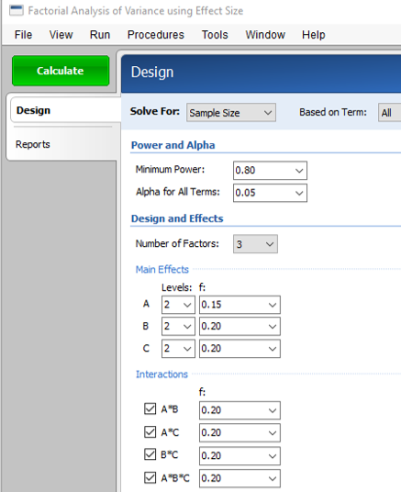
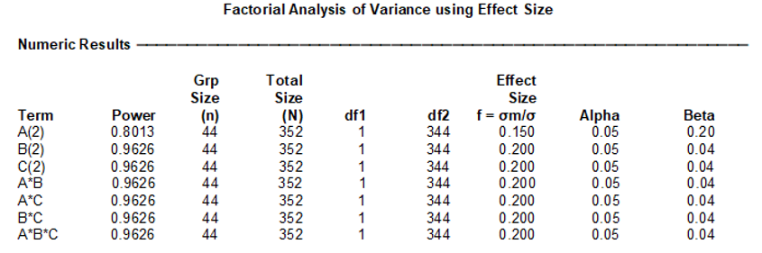
Comparison of experimental design options: sample size calculation for the factorial design
*Only allows ≤3

Slide 28
Factorial experiment designs for optimization
Screening experiment where ≥2 independent variables (factors) are systematically manipulated to achieve balance
  Complete/full design- all experimental conditions/combination of factors
  Fractional/reduced design- selected experimental conditions

Slide 29
Notation for 2-level complete factorial designs
2^{p} where p the number of factors and 2 indicates each factor has 2 levels
Examples | Levels per factor | # of factors (p) | Number of experimental conditions
2² (2x2) | 2 | 2 | 2x2=4
2³ (2x2x2) | 2 | 3 | 2x2x2=8
 |  | PEER
 |  | No | Yes
MI | No | 1. None | 2. PEER only
 | Yes | 3. MI only | 4. MI + PEER
MI: motivational interviewing; PEER: peer mentoring ; TEXT: text message support.
Collins, L. M. (2018). Optimization of behavioral, biobehavioral, and biomedical interventions: the multiphase optimization strategy (MOST). Springer.

Slide 30
Factor vs intervention component
Factor: An independent variable with different levels.
Examples
Factor | Type of levels | Levels | # of intervention components
Text reminder | Presence vs absence | Text 2 times/day vs no text | 1: text reminder
Reminder | Treatment alternatives: text reminder and phone reminder | Text 2 times/day vs call 2 times/day | 2: text reminder and phone reminder

Slide 31

Main effects of factors
Most important for decision making
Main effect of Factor A
  Effect of Factor A averaged across all levels of all other factors
${\hat{ME}}_{MI}={\overline{μ}}_{+∙∙}−$ ${\overline{μ}}_{−∙∙}$

Slide 32
“Control” is different in the RCT and the factorial experiment
Where is the control group?
Condition 1?

Slide 33
Each factor has its own control
Main effect of MI:
Mean of conditions 5-8 (Yes) vs mean of conditions 1-4 (No)
Main effect of PEER:
Mean of conditions 3, 4, 7, and 8 (Yes) vs mean of conditions 1, 2, 5, and 6 (No)
Main effect of TEXT:
Mean of conditions 2, 4, 6, and 8 (Yes) vs mean of conditions 1, 3, 5, and 7 (No)

Slide 34
Interactions between factors
Two-way interaction: interaction between Factors A and B
  ½ ((effect of Factor A at level 1 of Factor B) – (effect of Factor A at level 2 of Factor B))
^
^
Cell: 8 4 6 2 7 3 5 1

Slide 35
Balance property
Each level of each factor appears the same number of times
Every experimental condition has the same number of subjects
  Small variability ok
  But unbalanced data can be analyzed using General Linear Models (GLM)
Can be balanced even if it does not include all the possible combinations levels of factors (Fractional designs)
Unbalance may cause loss of power

Slide 36
Balance property
A balanced design ensures that the effect estimates are uncorrelated, when effect coding is used (not dummy coding).
Coding refers to how you represent the levels of the factors numerically.
Effect coding for three-level factor
Text message support | TEXT_LOW | TEXT_HIGH
No | -1 | -1
Low | 1 | 0
High | 0 | 1
Text message support | Effect coding | Dummy coding
No | -1 | 0
Yes | 1 | 1

Slide 37
General Linear Model (GLM) Approach
  Example of linear regression model with 3 factors
Intercept
Main effects
Interactions
  The following examples assume effect coding

Slide 38
Coding effects
Effect Codes
Experimental Condition (cell) | Main effects |  |  | Interactions
 | MI | PEER | TEXT | MI x PEER | MI x TEXT | PEER x TEXT | MI x PEER x TEXT
 | X₁ | X₂ | X₃ | X₄ | X₅ | X₆ | X₇
1 | -1 | -1 | -1 | +1 | +1 | +1 | -1
2 | -1 | -1 | +1 | +1 | -1 | -1 | +1
3 | -1 | +1 | -1 | -1 | +1 | -1 | +1
4 | -1 | +1 | +1 | -1 | -1 | +1 | -1
5 | +1 | -1 | -1 | -1 | -1 | +1 | +1
6 | +1 | -1 | +1 | -1 | +1 | -1 | -1
7 | +1 | +1 | -1 | +1 | -1 | -1 | -1
8 | +1 | +1 | +1 | +1 | +1 | +1 | +1

Slide 39
Coding effects
Effect Codes
Experimental Condition (cell) | Main effects |  |  | Interactions
 | MI | PEER | TEXT | MI x PEER | MI x TEXT | PEER x TEXT | MI x PEER x TEXT
 | X₁ | X₂ | X₃ | X₄ | X₅ | X₆ | X₇
 | -1β₁ | -1β₂ | -1β₃ | +1β₄ | +1β₅ | +1β₆ | -1β₇
2 | -1 | -1 | +1 | +1 | -1 | -1 | +1
3 | -1 | +1 | -1 | -1 | +1 | -1 | +1
4 | -1 | +1 | +1 | -1 | -1 | +1 | -1
5 | +1 | -1 | -1 | -1 | -1 | +1 | +1
6 | +1 | -1 | +1 | -1 | +1 | -1 | -1
7 | +1 | +1 | -1 | +1 | -1 | -1 | -1
8 | +1 | +1 | +1 | +1 | +1 | +1 | +1

Slide 40
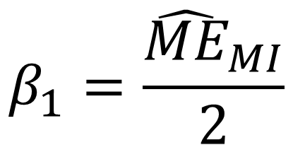

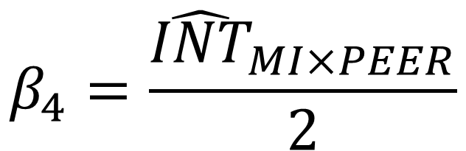
Coding effects
Main effects and interactions (Cohen’s definition) for a 2^{p} experiment
$$β_{1}=\frac{{\hat{ME}}_{MI}}{2}$$
$$β_{4}=\frac{{\hat{INT}}_{MI×PEER}}{2}$$
Where (as defined before)
${\hat{ME}}_{MI}={\overline{μ}}_{+∙∙}−$ ${\overline{μ}}_{−∙∙}$
^
CAVEAT: This depends on how you define the interaction INT. Fleiss’s define the interaction without dividing the difference-in-differences by 2 (See sections 3.14 and 4.7 in the Collins’ book for more details)
Cohen, J. (1988). Statistical power analysis for the behavioral sciences. Hillside, NJ: Lawrence Earlbaum Associates.

Slide 41
Part 2

Slide 42
Adding a factor
Additional factor with equal or larger expected effect size

Slide 43
Adding a factor
Additional factor with equal or larger expected effect size

Slide 44
Adding a level to a factor: Notation for mixed-level complete factorial designs
Mixed-level fractional designs can be created by mixing designs or factors with different levels
A design comprising some factors with 2 levels and other factors with 3 levels can be notated as
2^{p1} 3^{p2}
For example, a design with 2 two-level factors (p1) and 1 three-level factors (p2) is a 2² 3¹ or 2² 3 design. That is, a 2x2x3 factorial design with 12 experimental conditions

Slide 45
Adding a level for TEXT
Suppose TEXT has three levels: No, Low, High This is now a 2²3 design
 | Factorial Experiment
Experimental Condition (Cell) | MI | PEER | TEXT | n
1 | No | No | No | 29
2 | No | No | Low | 29
3 | No | No | High | 30
4 | No | Yes | No | 29
5 | No | Yes | Low | 29
6 | No | Yes | High | 30
7 | Yes | No | No | 29
8 | Yes | No | Low | 29
9 | Yes | No | High | 30
10 | Yes | Yes | No | 29
11 | Yes | Yes | Low | 29
12 | Yes | Yes | High | 30
Suppose expected effect size for TEXT contrasts unchanged
If you just divide original N=352, 44 per condition and 176 for each factor level for a 2³ design …
Need to increase sample size
Still
176
But only
116

Slide 46
Unless the expected effect size is larger
Suppose TEXT has three levels: No, Low, High This is now a 2²3 design
 | Factorial Experiment
Experimental Condition (Cell) | MI | PEER | TEXT | n
1 | No | No | No | 44
2 | No | No | Low | 44
3 | No | No | High | 44
4 | No | Yes | No | 44
5 | No | Yes | Low | 44
6 | No | Yes | High | 44
7 | Yes | No | No | 44
8 | Yes | No | Low | 44
9 | Yes | No | Yes | 44
10 | Yes | Yes | No | 44
11 | Yes | Yes | Low | 44
12 | Yes | Yes | Yes | 44
To maintain power, you would have to increase the N >=528 vs 352 with TEXT with 2 levels

Slide 47
Hypothetical example:
Developing an intervention to reduce viral load among HIV+ heavy drinkers
If 32 experimental conditions too much to handle, but 16 conditions would be manageable, what kind of optimization trial design?

Slide 48
Option A: Use 2⁴ design instead of 2⁵
Drop SKILLS
Experimental conditions with fractional conditions.

Slide 49
Option B: Use fractional design
Remove determined combina-tions
Fractional design:
  Balanced factorial designs that do not include all possible combinations of levels of the factors.
  Allow for estimation of main effects and lower-order interactions.
  SAS proc factex to design it

Slide 50
Comparison of experimental design options
Comparison of Features of Design Alternatives for Hypothetical HIV Study
Design | Number of Subjects Needed to Maintain Power ≥ .8 (d = .3) | Number of Experimental Conditions | Interactions
A. Individual Experiments | 1,760 | 10 | None can be estimated
B. Comparative Treatment | 1,056 | 6 | None can be estimated
C. Factorial (complete) | 352 | 32 | All can be estimated
D. Fractional factorial | 352 | 8 or 16 | Selected

Slide 51
Fractional factorial designs
Consider when
  A lot of conditions- 5 or more factors
    But can do for 3 and 4 factors
  Costs of conditions are relatively high
  Effects of scientific interest: main effects and lower-order interactions, such as two-way interactions
  Most of the remaining effects (i.e., higher order interactions) are expected to be negligible in size

Slide 52
Fractional factorial designs
Conditions to include
  NOT what you like; SELECT on a statistical basis
    Many designs to choose from; have different properties
    Starting point:
      Identify effects you are willing to assume are negligible (e.g., higher-order interactions)
    Can be selected using books
      Wu and Hamada 2009. Experiments: Planning, analysis, and optimization (2nd ed.).
    Easiest way is to use software
      PROC FACTEX in SAS
      AlgDesign in R

Slide 53
Notation for two-level fractional factorial designs
2^{p-r}
where p the number of factors and 2 indicates each factor has 2 levels as before, and r is the size of the fraction of the full design. If r=1 it is a half fraction design as 2⁻¹ =1/2.
For example, a 2³⁻¹ factorial design means that the design is a half-fraction design of a 2³ design, a full design with 3 factors each with 2 levels. That is, it has 4 experimental conditions instead of the 8 of the full design.

Slide 54
Example of half-fraction design with three components
8 experimental conditions too much to handle
4 conditions would be manageable

Slide 55
Example of half-fraction design with three components
Conditions for half-fraction designs can be selected by simply choosing one level (1 or -1) of the highest-order interaction

Slide 56
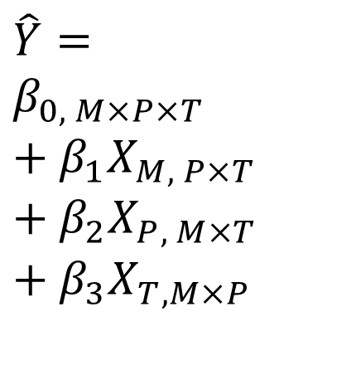
Example of half-fraction design with three components
Once you remove half of the experimental conditions, you can estimate only half of the effects
Each of these effects is a combination of two of the effects from the complete factorial
$$\hat{Y}=$$
$$β_{0, M×P×T}+β_{1}X_{M, P×T}+β_{2}X_{P, M×T}+β_{3}X_{T, M×P}$$

Slide 57
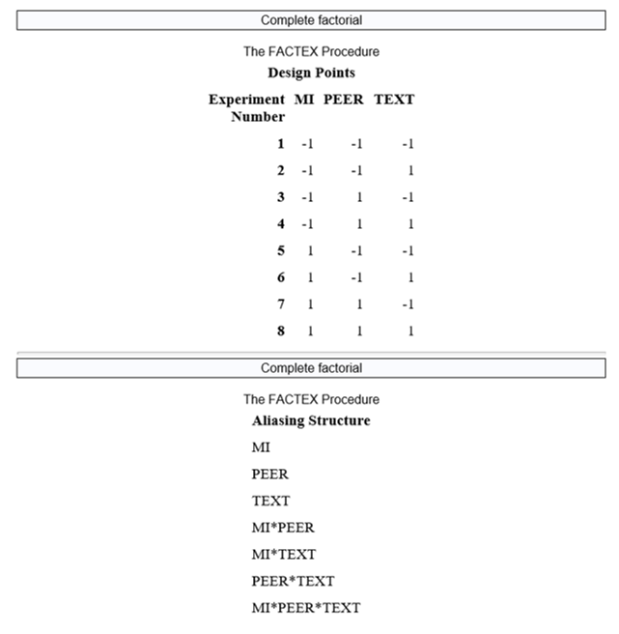
Using SAS proc factex to design FULL factorial experiments
proc factex;
title Complete factorial;
factors MI PEER TEXT;
model resolution=maximum;
examine aliasing (3) design;
size design=8;
run;
quit;
Names of factors
Number of conditions

Slide 58
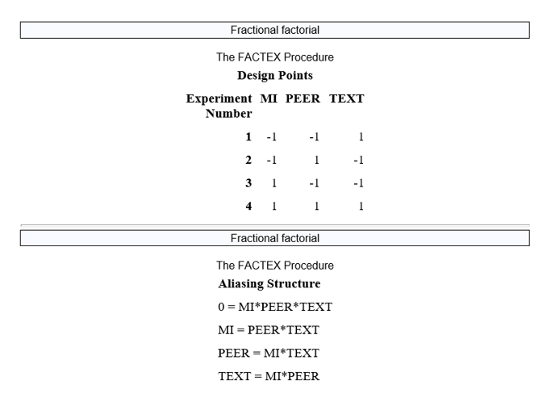
Using SAS proc factex to design FRACTIONAL factorial experiments
proc factex;
title Fractional factorial;
factors MI PEER TEXT;
model resolution=maximum;
examine aliasing (3) design;
size design=4;
run;
quit;
Names of factors
Number of conditions

Slide 59
Factorial designs with clustered subjects
Subjects may be clustered (clinics, schools, households, etc.)
Subjects within a cluster may be more similar to each other than compared to subjects from other clusters
In many situations, interventions are delivered at the cluster level
For cluster randomized designs, usually, more subjects are needed to maintain power as compared with individual randomized designs given everything else is the same (e.g., effect size, total sample size, etc.)
  This depends on both the intraclass correlation and the number of factors

Slide 60
Examples of power and sample size calculations for a cluster randomized full factorial design using %FactorialPowerPlan

Slide 61
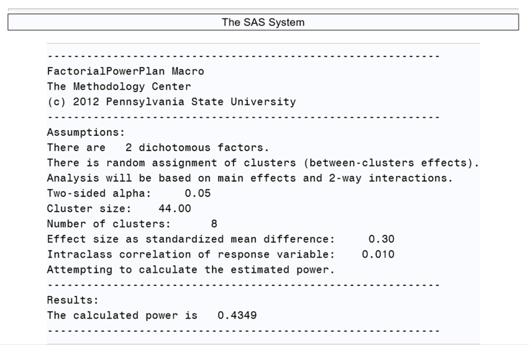
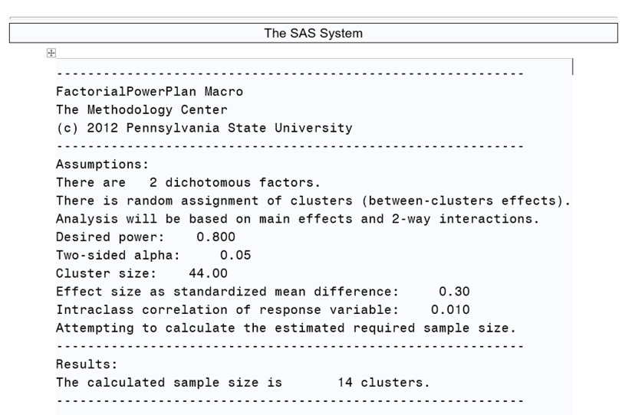
Examples of power and sample size calculations for a cluster randomized full factorial design using %FactorialPowerPlan
Power with 8 clusters (2 factors; ICC=0.01; 8 clusters of size 44 (N=352))
%FactorialPowerPlan(assignment=between, model_order=2, nfactors=2, d_main=0.3, cluster_size=44, icc=.01, nclusters=8);
Number of clusters (2 factors; ICC=0.01; clusters of size 44; 80% power)
%FactorialPowerPlan(assignment=between, model_order=2, nfactors=2, power=0.8, d_main=0.3, cluster_size=44, icc=.01);

Slide 62
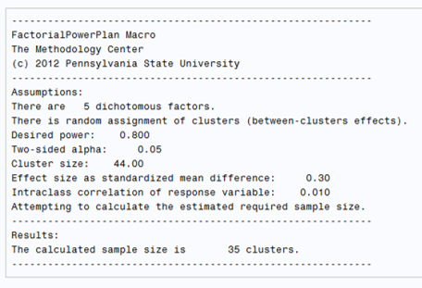
Examples of power and sample size calculations for a cluster randomized full factorial design using %FactorialPowerPlan
Increasing the number of factors increases the required number of clusters
  Number of clusters (5 factors; ICC=0.01; clusters of size 44; 80% power)
    %FactorialPowerPlan(assignment=between, model_order=5, nfactors=5, power=0.8, d_main=0.3, cluster_size=44, icc=.01);

Slide 63
Optimizing adaptive interventions
 |  | Objective
Fixed intervention | Participants are offered the same set of intervention components in a uniform manner | Everyone improves
Adaptive intervention | Sequence of pre-specified decision rules that can be used to guide whether, how, or when—and based on which measures—to alter an intervention or intervention component (e.g., treatment type, duration, frequency or amount) at critical decision points during the course of care. Mimics decisions in real-life settings- intervention options are assigned (different treatments or sequence of treatments) to accommodate the specific and changing needs of individuals and their characteristics (e.g., gender, clinical history, response to treatment, etc.) | Everyone brought to the same or a minimal level

Slide 64
Design of a hypothetical adaptive intervention (not a study design)
Adherent
to HIV treatment
TEXT and PEER
TEXT, PEER, and SKILLS
Non-adherent
to HIV treatment
TEXT, PEER, and MI
Day 45

Slide 65
Collins, LM (2018). Optimization of behavioral, biobehavioral, and biomedical interventions. New York: Springer.

Slide 66
Sequential multiple-assignment randomized trial (SMART)
A multi-stage, factorial, randomized trial
  Each stage corresponds to a decision point
  Randomizations take place at decision points
  Some (or all) participants are randomized more than once, often based on earlier covariates, patient’s response
Special case of the factorial experiment
Goal: gather information needed to optimize an adaptive intervention
Collins, LM (2018). Optimization of behavioral, biobehavioral, and biomedical interventions. New York: Springer.
Kidwell KM, Almirall D. Sequential, Multiple Assignment, Randomized Trial Designs. JAMA. 2023 Jan 24;329(4):336-337.

Slide 67
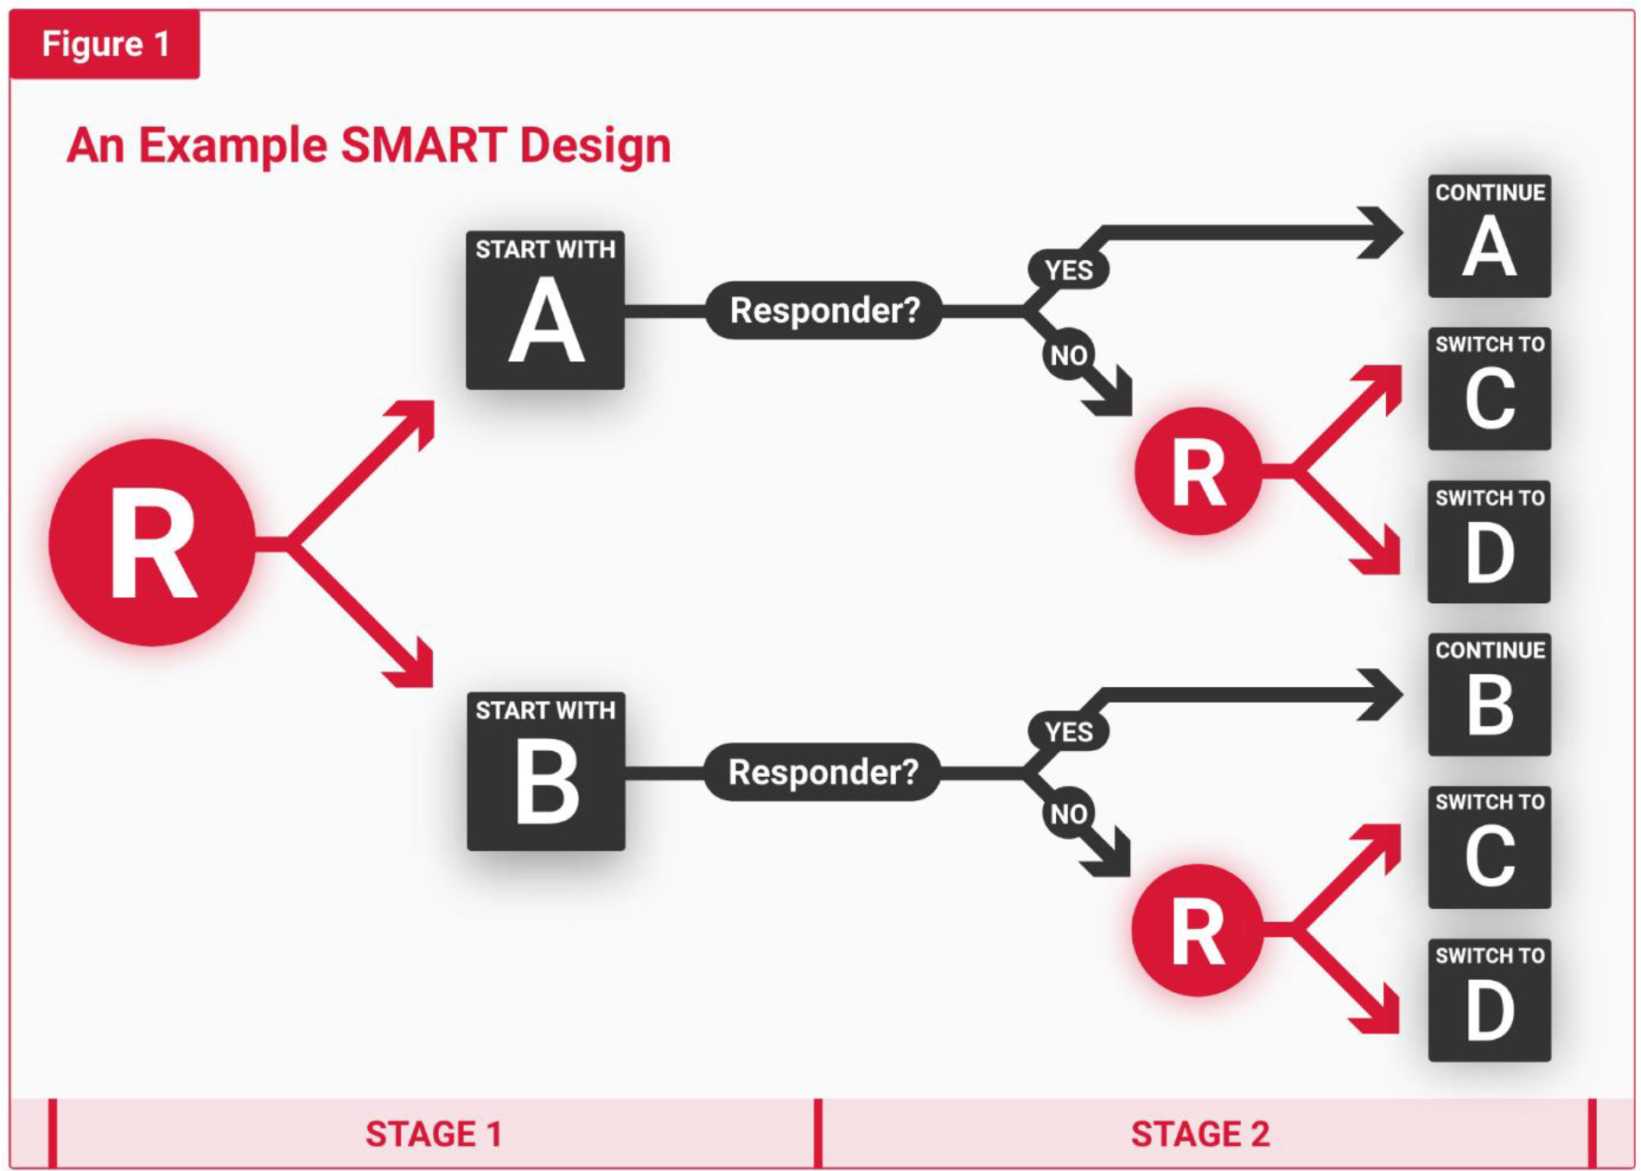
Kidwell KM, Almirall D. Sequential, Multiple Assignment, Randomized Trial Designs. JAMA. 2023 Jan 24;329(4):336-337.
Notes:
Prototypical SMART
All randomized at start of Stage 1, to either A or B
Non-responders re-randomized at start of Stage 2, to either C or D
Stage 1 A vs B comparison
Stage 2 C vs D comparison
Four adaptive interventions:
AA, AC: “Start with treatment A in stage 1 and assess the patient for early signs of response at the end of stage 1. If the patient is an early responder, continue treatment A in stage 2; whereas, if the patient is a non-responder switch to treatment C in stage 2.”
AA, AD; BB, AC; and BB, AD.

Slide 68
SMART Example 1

Slide 69
Design of one adaptive intervention (not a study design)
Almirall D, Kasari C, McCaffrey DF, Nahum-Shani I. Developing Optimized Adaptive Interventions in Education. J Res Educ Eff. 2018;11(1):27-34.
DDT, Discrete Trial Teaching

Slide 70
Two-arm randomized trial comparing two adaptive interventions
Almirall D, Kasari C, McCaffrey DF, Nahum-Shani I. Developing Optimized Adaptive Interventions in Education. J Res Educ Eff. 2018;11(1):27-34.
DDT, Discrete Trial Teaching; JASPER, Joint Attention Symbolic Play Engagement and Regulation intervention

Slide 71
SMART design
Almirall D, Kasari C, McCaffrey DF, Nahum-Shani I. Developing Optimized Adaptive Interventions in Education. J Res Educ Eff. 2018;11(1):27-34.
DDT, Discrete Trial Teaching; JASPER, Joint Attention Symbolic Play Engagement and Regulation intervention

Slide 72
SMART Example 2

Slide 73
Design of an hypothetical adaptive intervention (not a study design)
SMART design of hypothetical intervention
Adherent
to HIV treatment
TEXT and PEER
TEXT, PEER, and SKILLS
Non-adherent
to HIV treatment
TEXT, PEER , and MI
Day 45
Tailoring variable - adherence
Notes:
This hypothetical example is about an intervention to encourage HIV treatment adherence. Strict and very strict are the two levels of the tailoring variable (adherence) intervention component to which subjects are initially randomized. The initial research question here is whether it is better to define non-adherence using a strict criterion (80% adherence) vs a very strict criterion (90% adherence within, with no more than one day in the 14-day period without medication). Both groups initially receive the intervention package consisting of text messaging, peer mentoring, and behavioral skills training. Adherence is measured at day 45 and people are classified as adherent and non-adherent depending on the criterion to which they were randomized. Then, at each level of the tailoring variable, adherent participants are randomized to receive either texts only or text plus 4 more weeks of peer mentoring, while non-adherent participants are randomized to continue with texts and peer mentoring or that plus the additional component motivational interviewing.

Slide 74
Main effect of tailoring
Mean of A, B, C, and D
Vs
Mean of E, F, G, and H
Tailoring variable - adherence

Slide 75
Main effect of continuing peer mentoring:
Mean of A and E
Vs
Mean of B and F
Which treatment option is better for adherents?
Tailoring variable - adherence

Slide 76
Which treatment option is better for NON-adherents?
Main effect of continuing peer mentoring:
Mean of C and G
Vs
Mean of D and H
Tailoring variable - adherence

Slide 77
SMART Example 3

Slide 78
Consort chart of SMART of adaptive intervention for school-age
DDT, Discrete Trial Teaching
JASPER, Joint Attention Symbolic Play Engagement and Regulation intervention
Kasari C, Shire S, Shih W, Kaiser A, Lord C, Levato L, Smith T, Almirall D. Adaptive Intervention for School-Age, Minimally Verbal Children With Autism Spectrum Disorder in the Community: Primary Aim Results. J Am Acad Child Adolesc Psychiatry. 2025 Jun;64(6):674-685.
Notes:
Outcome is socially communicative utterances (SCU)

Slide 79
Results of primary analysis for primary outcome
Kasari C, Shire S, Shih W, Kaiser A, Lord C, Levato L, Smith T, Almirall D. Adaptive Intervention for School-Age, Minimally Verbal Children With Autism Spectrum Disorder in the Community: Primary Aim Results. J Am Acad Child Adolesc Psychiatry. 2025 Jun;64(6):674-685.

Slide 80
Results of secondary analysis for primary outcome
“Three-letter abbreviation denoting each of the 8 interventions.
The first letter denotes stage 1 intervention; there are 2 choices: J = JASP-EMT or D = DTT.
The second letter denotes stage 2 intervention among early responders; there are 3 choices: J = continue JASP-EMT, P = add Parent Training, or D = continue DTT.”
All are adaptive interventions, except JJJ.
Kasari C, Shire S, Shih W, Kaiser A, Lord C, Levato L, Smith T, Almirall D. Adaptive Intervention for School-Age, Minimally Verbal Children With Autism Spectrum Disorder in the Community: Primary Aim Results. J Am Acad Child Adolesc Psychiatry. 2025 Jun;64(6):674-685.

Slide 81
Collins, L.M. (2018). Optimization of Behavioral, Biobehavioral, and Biomedical Interventions: The Multiphase Optimization Strategy (MOST). New York: Springer.

Slide 82
Identify the intervention that meets optimization criterion
Some options
  All active components
  If there are constraints regarding the magnitude of the component effects, the implementation cost or time
    Most effective intervention that can be implemented for < some $
      “largest expected value of adhere that can be obtained for an implementation cost of no more than $500 per person”
    Most cost-effective component(s)
    Most effective intervention that can be completed in < some time

Slide 83
Example of an intervention prepared and optimized using the MOST approach

Slide 84
Tobacco dependence treatment in the emergency department
Results of preparation activities
Optimization

Slide 85
Preparation phase- optimization criteria

Slide 86
Optimization phase
Full factorial with 4 experimental components (2⁴ design)

Slide 87
Optimization phase
Statistical power

Slide 88
Results of optimization trial
Results of optimization trial
- No statistically significant interactions were identified
- But study wasn’t powered for that
- No statistically significant interactions were identified (Results reported in appendix)
- But study wasn’t powered for that

Slide 89
Next steps
Finishing optimization phase: Qualitative and economic analyses
Identifying optimal methods to scale the motivational interviewing and nicotine replacement interventions
MOST evaluation phase: Testing their combined effectiveness in a new clinical trial

Slide 90
MOST
Evaluation phase

Slide 91
Collins, L.M. (2018). Optimization of Behavioral, Biobehavioral, and Biomedical Interventions: The Multiphase Optimization Strategy (MOST). New York: Springer.

Slide 92
Evaluation design
Evaluate optimized multicomponent intervention or implementation strategy
Parallel RCT (individual or cluster randomization)
  Fixed intervention design
    Optimized fixed intervention vs control group
  Adaptive intervention design
    Optimized adaptive intervention vs control group (e.g., fixed intervention)
Other designs used in implementation science
  Alternative randomized designs
      Step wedge designs; Factorial designs; SMART
  Quasi-experimental/observational
    Pre-post design with nonequivalent control group; Regression discontinuity; Interrupted time series
  Effectiveness-implementation hybrid designs (using designs from above) - to evaluate both intervention effects and implementation
  Mixed methods designs (e.g., using trial designs from above plus qualitative research to understand implementation)
Brown CH et al. An Overview of Research and Evaluation Designs for Dissemination and Implementation. Annu Rev Public Health. 2017 Mar 20;38:1-22.
Hwang S et al. Designs and methods for implementation research: Advancing the mission of the CTSA program. J Clin Transl Sci. 2020 Mar 4;4(3):159-167.
Palinkas LA et al. Mixed method designs in implementation research. Adm Policy Ment Health. 2011 Jan;38(1):44-53.

Slide 93
Published research using MOST
Up to Sep 2020 - Systematic review of MOST publications - Landoll RR et al. Transl Behav Med. 2022
  Preparation phase - results: 12
  Optimization phase
    Protocol of trial: 21
    Results of trial: 17
  Evaluation phase - results of trial: 1
  Other (e.g., example or review of MOST framework): 5
  Up to 2024 – Scoping review of optimization – Nolan E et al. BMC Health Services Research 2025
  Optimization phase - results of trial: 28
  Evaluation phase – results of trial (I am aware of)
  Piper ME et al. Ann Behav Med. 2018
  Tanner AE et al. Ann Behav Med. 2021 (Example in the next slides)

Slide 94
MOST
Examples

Slide 95
Example of an intervention developed, optimized, and evaluated using the MOST approach

Slide 96
itMatters, an online intervention that targets the intersection of alcohol use and sexual behaviors to reduce sexually transmitted infections (STIs) among college students
Optimization of Behavioral, Biobehavioral, and Biomedical Interventions: Advanced Topics. 2018:1–21.

Slide 97
Preparation phase

Slide 98
Preparation phase

Slide 99
Optimization phase
Full factorial with 5 experimental components (2⁵ design) and a constant component
Optimization criteria
  All active components: significant p-value (p <.05) was the specified criterion for inclusion in the optimized intervention

Slide 100
Revisions based on feedback (focus groups and interviews)
- Changed narrator (students’ feedback)
- Shortened length (administrator feedback)
- Made measures more concise (Expert Advisory Panel feedback)
“two components met our inclusion criteria: a component that focused on correcting erroneous descriptive norms (i.e., prevalence norms) and a component that focused on correcting erroneous injunctive norms (i.e., approval norms)”

Slide 101
Evaluation phase
Two goals:
(a) Evaluation: to evaluate the optimized itMatters intervention
    Components: information, descriptive norms, and injunctive norms
(b) Optimization: to determine whether a candidate component had a detectable effect and therefore should be added to create a new version of itMatters
    Candidate component: sexual violence prevention (SVP) component (included at the request of participating universities). Covers:
      (a) essential sexual violence educational content (e.g., important definitions, prevalence, and consent)
      (b) information related to campuses’ responsibilities for reporting acts of sexual violence and other related crimes
      (c) bystander intervention training that also included safe and effective steps to be an active “upstander”

Slide 102
Design: 2 x 2 factorial

Slide 103
Optimization results for SVP component
“SVP component had a significant main effect on .. using inappropriate language (d = 0.29) and knowing where to get help (d = 0.22) … assess the environment (d = 0.29) and look for support (d = 0.23).”
Results disappeared by the 60-day follow up.
N=3,098 at baseline, 2,298 immediate follow-up, and 1,836 at the 60-day follow-up

Slide 104
Evaluation results for itMatters
“Significant main effect of itMatters on the proximal outcomes of descriptive (d = 0.53) and injunctive norms (d = 0.84) at the immediate … maintained at the 60-day … reduced binge drinking at the 60-day (B = −0.10, 95% CI = −0.20, −0.01).”
N=3,098 at baseline, 2,298 immediate follow-up, and 1,836 at the 60-day follow-up

Slide 105
Conclusions of the hybrid evaluation-optimization trial of itMatters and SVP component
itMatters evaluation
  itMatters effectively changed proximal outcomes and a behavioral (binge drinking) outcome
  To see an effect in sexual behaviors in the context of alcohol use, investigators suggested that targeting a population at higher risk, providing booster’s sessions, and/or a longer follow-up may be needed.
SVP component optimization
  Preliminary evidence of effects on proximal outcomes
  Investigators will further optimize it (revise and retest) before considering including it in the itMatters intervention.

Slide 106
Overall conclusions
MOST
  Framework for developing optimized multicomponent interventions, including implementation strategies
  Build interventions using empirically based optimization
  Factorial and SMART designs could be used to optimize interventions
  Multicomponent interventions that are more effective, economical, efficient, and scalable can be developed by implementing MOST

Slide 107
Thank you

